Slide 1
Enteric Gram-Negative Rods
( Enterobacteriaceae)
The Enterobacteriaceae are a large, heterogeneous group of gram-negative rods whose natural habitat is the intestinal tract of humans and animals.
Include:
Escherichia, Shigella, Salmonella, Enterobacter, Klebsiella, Serratia, Proteus, and others. Some enteric organisms, such as Escherichia coli, are part of the normal microbiota and incidentally cause disease, but others, the salmonellae and shigellae, are regularly pathogenic for humans.

Slide 2
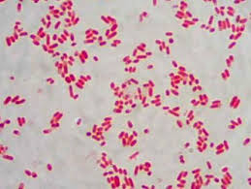
Morphology and Identification
Enterobacteriaceae are short gram-negative rods.
Typical morphology is seen in growth on solid media in vitro, but morphology is highly variable in clinical specimens.
Capsules are large and regular in Klebsiella species, less so in Enterobacter species, and uncommon in the other species.

Slide 3
Enterobacteriaceae
The Enterobacteriaceae are:
* facultative anaerobes or aerobes
* ferment a wide range of carbohydrates
* possess a complex antigenic structure, and
*produce a variety of toxins and other virulence factors.
enteric gram-negative rods, and enteric bacteria are the terms used in this family, but these bacteria may also be called coliforms.

Slide 4
Culture & Growth Characteristics
E coli and most of the other enteric bacteria form circular, convex, smooth colonies with distinct edges. Enterobacter colonies are similar but somewhat more mucoid. Klebsiella colonies are large and very mucoid. The salmonellae and shigellae produce colonies similar to E coli but do not ferment lactose. Some strains of E coli produce hemolysis on blood agar.
Carbohydrate fermentation patterns.
production of indole from tryptophan, Voges Proskauer reaction.
Media that contain special dyes and carbohydrates (e. g, eosin-methylene blue [EMB], MacConkey, or deoxycholate medium) distinguishes lactose-fermenting (colored) from non–lactose-fermenting colonies (nonpigmented) and may allow rapid presumptive identification of enteric bacteria

Slide 5
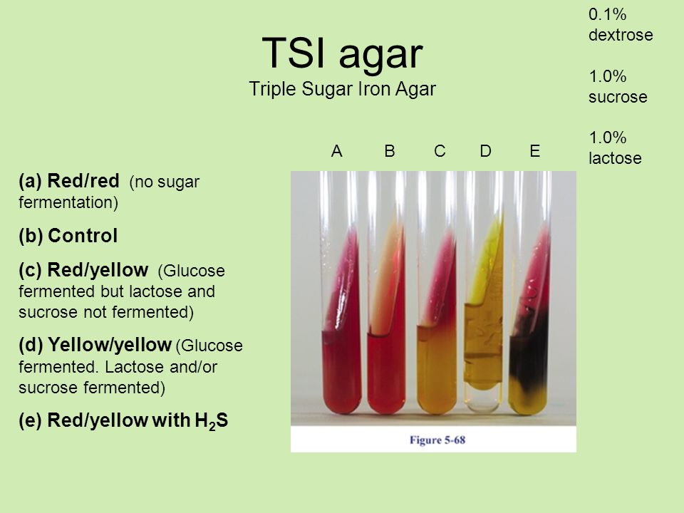
TSI
Media have been devised to help in identification of the enteric bacteria:
Triple sugar iron (TSI) agar, which is often used to help differentiate salmonellae and shigellae from other enteric gram-negative rods in stool cultures.
The medium contains 0.1% glucose, 1% sucrose, 1% lactose, ferrous sulfate (for detection of H₂S production), tissue extracts (protein growth substrate), and a pH indicator (phenol red). It is poured into a test tube to produce a slant with a deep butt and is inoculated by stabbing bacterial growth into the butt.

Slide 6
TSI
If only glucose is fermented, the slant and the butt initially turn yellow from the small amount of acid produced; as the fermentation products are subsequently oxidized to CO₂ and H₂O and released from the slant and as oxidative decarboxylation of proteins continues with formation of amines, the slant turns alkaline (red).
If lactose or sucrose is fermented, so much acid is produced that the slant and butt remain yellow (acid). Salmonellae and shigellae typically yield an alkaline slant and an acid butt. Although Proteus, Providencia, and Morganella species produce an alkaline slant and acid butt, they can be identified by their rapid formation of red color in Christensen’s urea medium.
Organisms producing acid on the slant and acid and gas (bubbles) in the butt are other enteric bacteria.

Slide 7
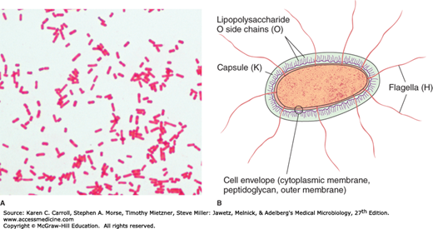
Antigenic Structure
Enterobacteriaceae have a complex antigenic structure:
* O antigens: They are classified by more than 150 different heat-stable somatic O
(lipopolysaccharide) antigens,
* K antigens: More than 100 heat-labile K (capsular) antigens, and
* H antigens: More than 50 H (flagellar) antigens
In Salmonella serotype Typhi, the capsular antigens are called Vi antigens.

Slide 8
Escherichia coli
Present in GUT- Normal flora
Endogennous
Belongs to enterobacteriacae family

Slide 9
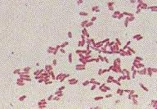
Identification
Gram negative rod
Motile
Capsule may be found in some strains
Does not form spores

Slide 10
E. coli
Aerobe and facultative anaerobe
Optimum temperature for growth 37C
Tolerates bile salt, Grows on MacConkey agar forms pink colour colonies due to lactose fermentation
Metalic green sheen on Eosin Methylene Blue agar (EMB)
IMViC + + - - (Indole, methyl red, VP, Citrate

Slide 11
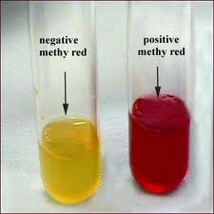
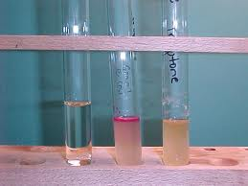
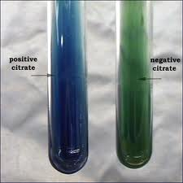
IMViC

Slide 12
Antigenic structure
O somatic
H flagellar
K capsular
K has a strong association with virulence, particularly meningitis, pyelonephritis

Slide 13
Factors of pathogenicity and virulence
Endotoxin
Capsule
Antigenic variation
Exotoxin- Hemolysins, Enterotoxins- LT, ST, VT
Adhesins, fimbriae

Slide 14
Infections
Urinary tract infection
Diarrhoea
Pyogenic/wound infection-post surgical
Septicemia
Neonatal meningitis

Slide 15
Urinary tract infections
E. coli is the most common cause of UTI
Account for 90% of cases in sexually active women, Why?
Ascending infection

Slide 16
Types of diarrheagenic E.coli
ETEC entero toxic E. coli
EIEC- entero invasive E. coli
EPEC enetro pathogenic
EAEC entero aggregative
EHEC entero haemorrhagic- some strains can cause “Hemolytic uremic syndrome”

Slide 17
Toxins
LT–is heat labile and binds to specific Gm11 gangliosides on epithelial cells of small intestine where it stimulates production of cAMP.
Increased cAMP opens up chloride channel, leading to Cl secretion in to bowel lumen. Sodium follows to maintain electroneutrality. Resulting in secretory diarrhoea which is watery.

Slide 18
Entero toxigenic E. coli (ETEC)
Produce 2 types of enterotoxin: LT & ST
Entero toxigenic E coli is common cause for travellers diarrhoea and watery diarrhoea in children.

Slide 19
Entero pathogenic E. coli (EPEC)
Important cause of diarrhoea in infants of developing countries.
Adhere to mucosal cells in small bowel, lead to loss of microvilli, result in watery diarrhoea.
Normally do not produce toxins, NON INVASIVE

Slide 20
Entero hemorrhagic E. coli (EHEC)
Produce verotoxin (VT) also called Shiga like toxin.
Toxin acts systemically- vascular endothelium
Clinically it can cause mild to severe form of diarrhoea with hemorrhagic colitis, and potentially fatal Hemolytic uremic syndrome in young children and elderly
Typical example is E coli O157:H7,

Slide 21
Entero invasive E. coli (EIEC)
Produces disease similar to shigella
Commonly affect children in developing countries and travellers.
Disease is due to invasion in to mucosal cells of intestine. Bacteria multiply inside epithelial cells and destruction/ inflammation /ulceration occurs with bloody diarrhoea with mucus and necrotic tissue

Slide 22
Entero aggregative E. coli (EAEC)
Produce acute/chronic diarrhoea in persons in developing countries.

Slide 23
Mechanism of E. coli infection

Slide 24
Klebsiella spp.

Slide 26
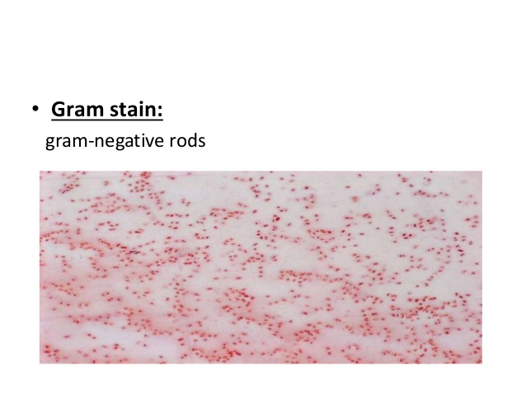
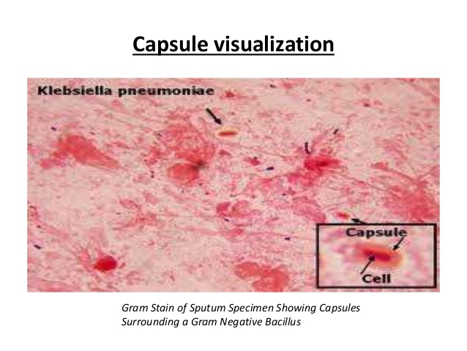

Slide 29
